Slide 1

Neurophysiological Correlates of Sleep: Investigating Brain Activity Patterns and How it Impacts Health Outcomes
Team: Sleeping Beauty
Team members: Lisong He, Bowen Deng, Iuliia Dmitrieva, Kaixuan Zhang
02/04/2024

Slide 2

Why Sleep?

Slide 3

Research Goal
To examine the neurophysiological sleep patterns across different age groups, focusing on medication and specific conditions like insomnia and sleep apnea.

Slide 4
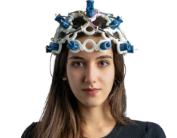
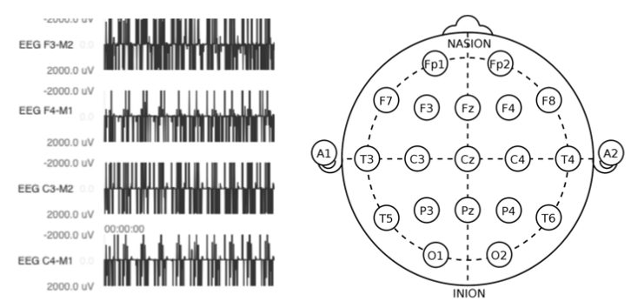
Data Source
The dataset is from the National Sleep Research Source, specifically, the Nationwide Children's Hospital - Sleep DataBank dataset. This dataset has over 4000 sleep recordings and supporting data, which includes 2 parts: the sleep data and the health data.
sleep_data
EEG recording (edf format for brain’s electrical activity)

Slide 5
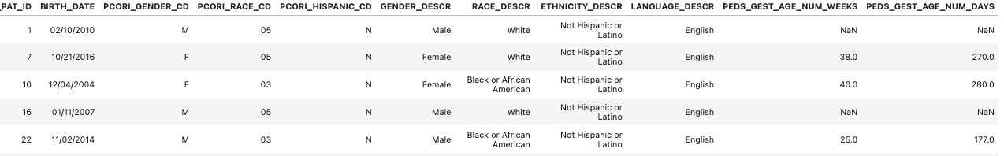
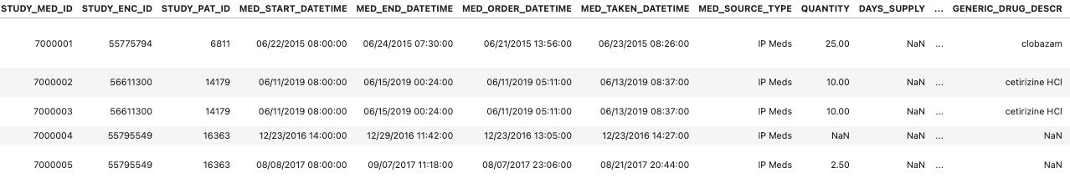
health_data
Diagnosis.csv - diagnosis information upon a patient
Demographic.csv - basic information of a record patient
Encounter.csv
Measurement.csv
Meditation.csv - the medicine time record given during the therapeutic process
Procedure.csv - record of usage medication and monitoring of lab tests
Sleep_study.csv

Slide 6
Data Preprocessing
Data Segmentation by Age:
segment the data into distinct age groups.
physiological characteristics of individuals change with age
Processing Sleep Recordings:
MNE package and Fourier Analysis.
convert signals into component frequencies
extracting detailed information about different sleep stages and frequency bands
Matching Sleep and Health Data:
matching dataset with patient’s id
combine and establish a large dataframe for further analysis

Slide 7

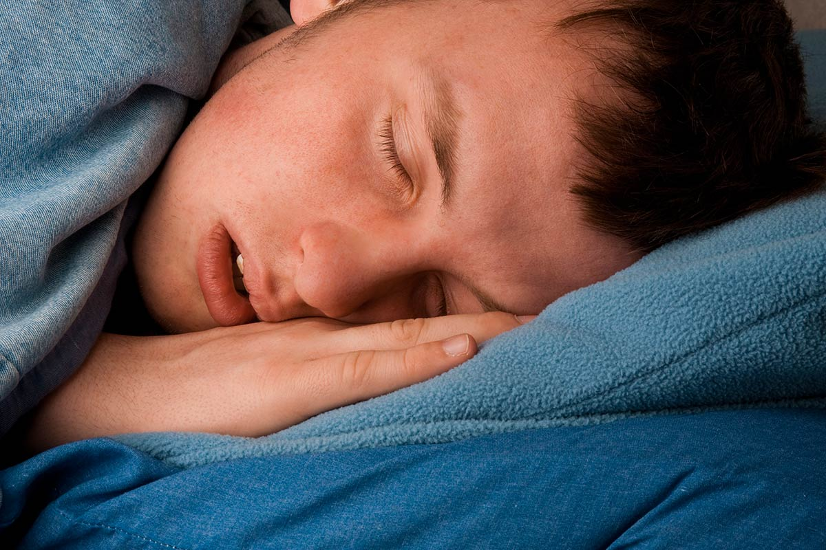

Identify Age Groups
Children (0-12 years)
Adolescents (13-17 years)
Adults (18-68 years)
Sampling age ( 0-68 years)

Slide 8

The MNE (MEG and EEG ) package is a comprehensive Python library designed for processing and analyzing electrophysiological data, such as EEG, MEG, and sEEG. Not only can it reduce noise, it also examines the complex activity patterns and facilitates the understanding of neural mechanisms.

Slide 9
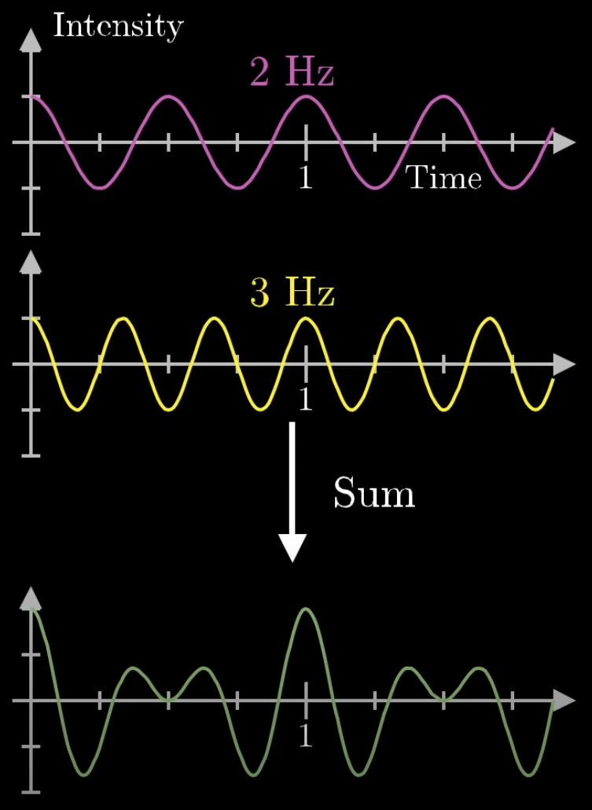
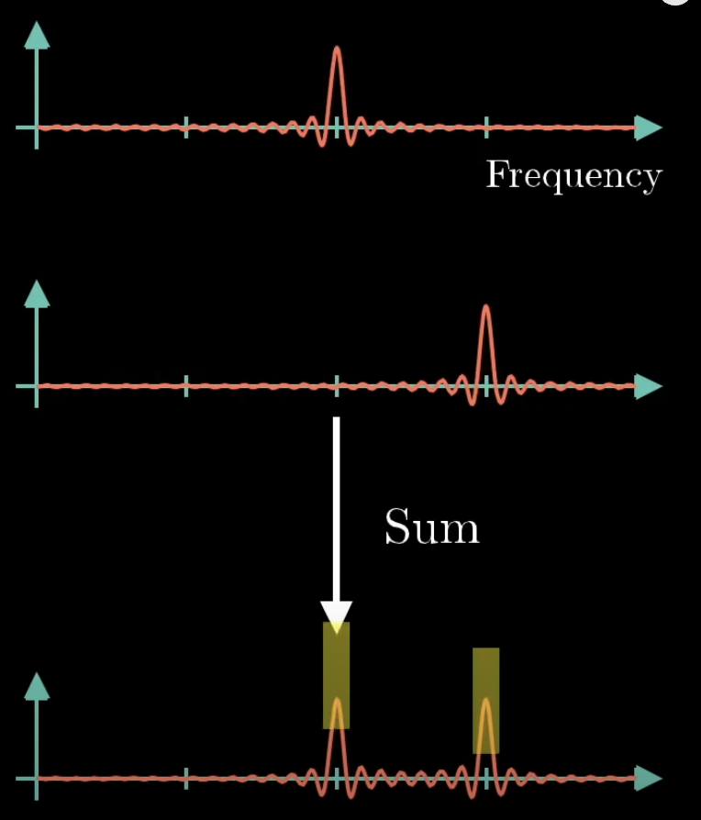
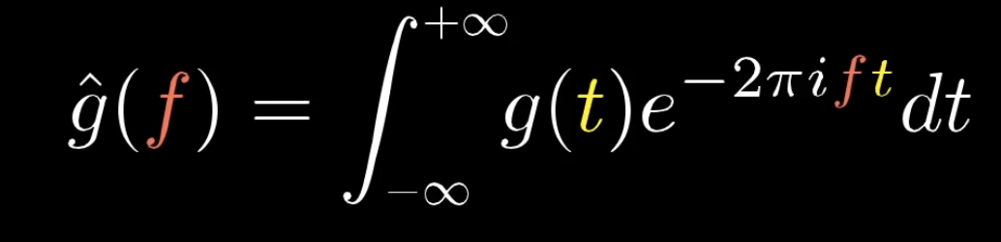
Fourier Transform

Slide 10
Fast Fourier Transform (FFT)
An algorithm that computes the Discrete Fourier Transform quickly.
Enables us to handle large sleep data sets efficiently.
Vital for real-time data analysis.
Our ideal choice!

Slide 11

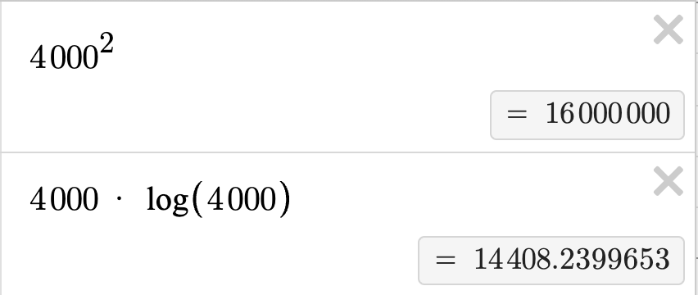
Fast Fourier Transform
Time complexity:
O(n*log(n))
Directly solving Discrete Fourier Transform
Time complexity:
O(n*n)

Slide 12
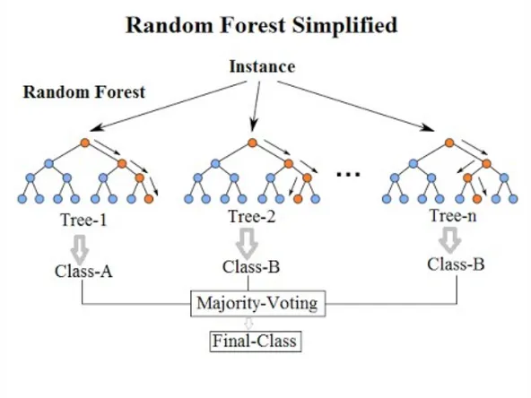
Machine learning analysis
•Step 1 Detecting sleep apnea
•Method: supervised learning algorithms (Random Forest, SVM)
•to classify our sleep dataset by constructing a multitude of decision trees or mapping into a hyperplane

Slide 13
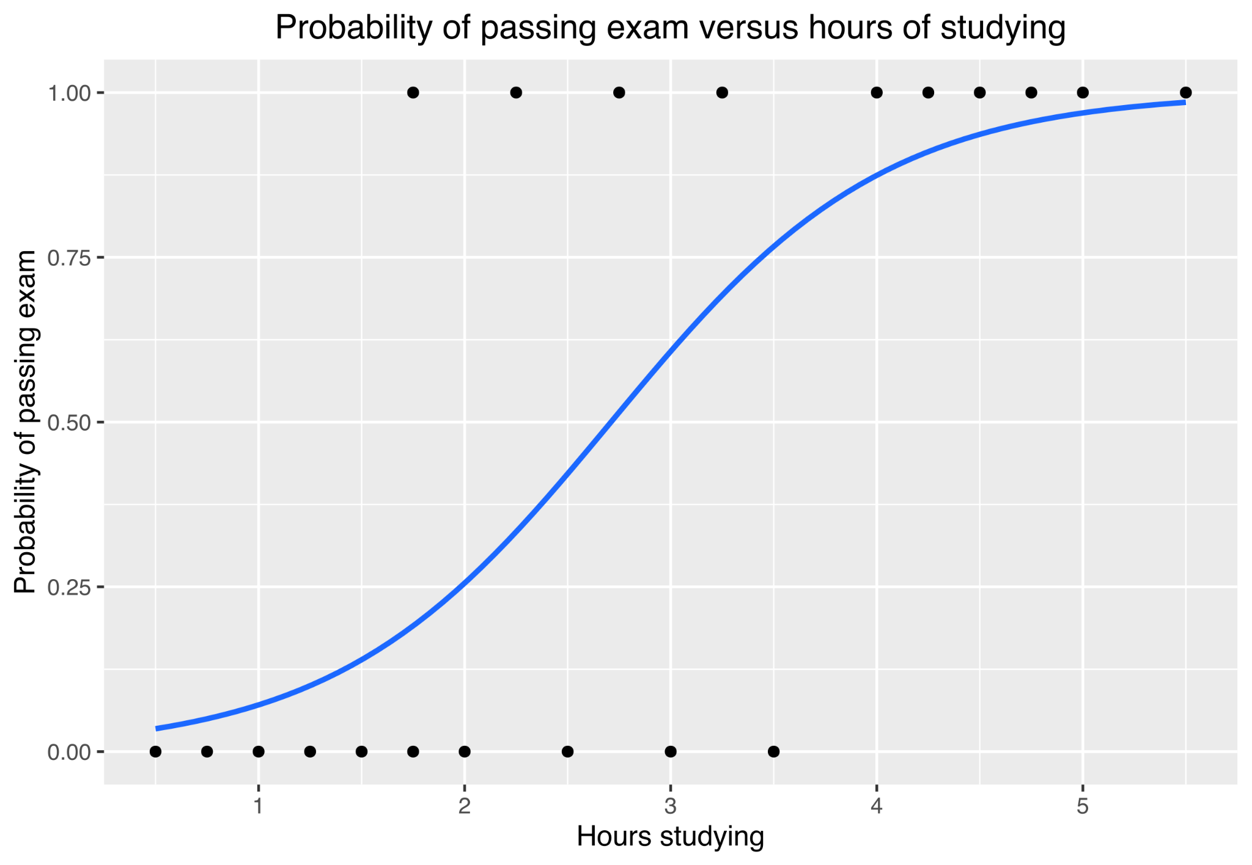
Machine learning analysis
•Step 2 Predicting the probability
•Method: Logistic regression
•Building binary variables to model the probability of diagnosing sleep apnea

Slide 14
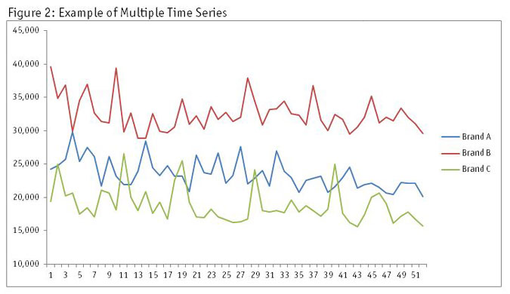
Machine learning analysis
•Step 3 Finding changes of patients’ records
•Method: Time series analysis
•to detect changes of several criteria we interest in over time

Slide 15
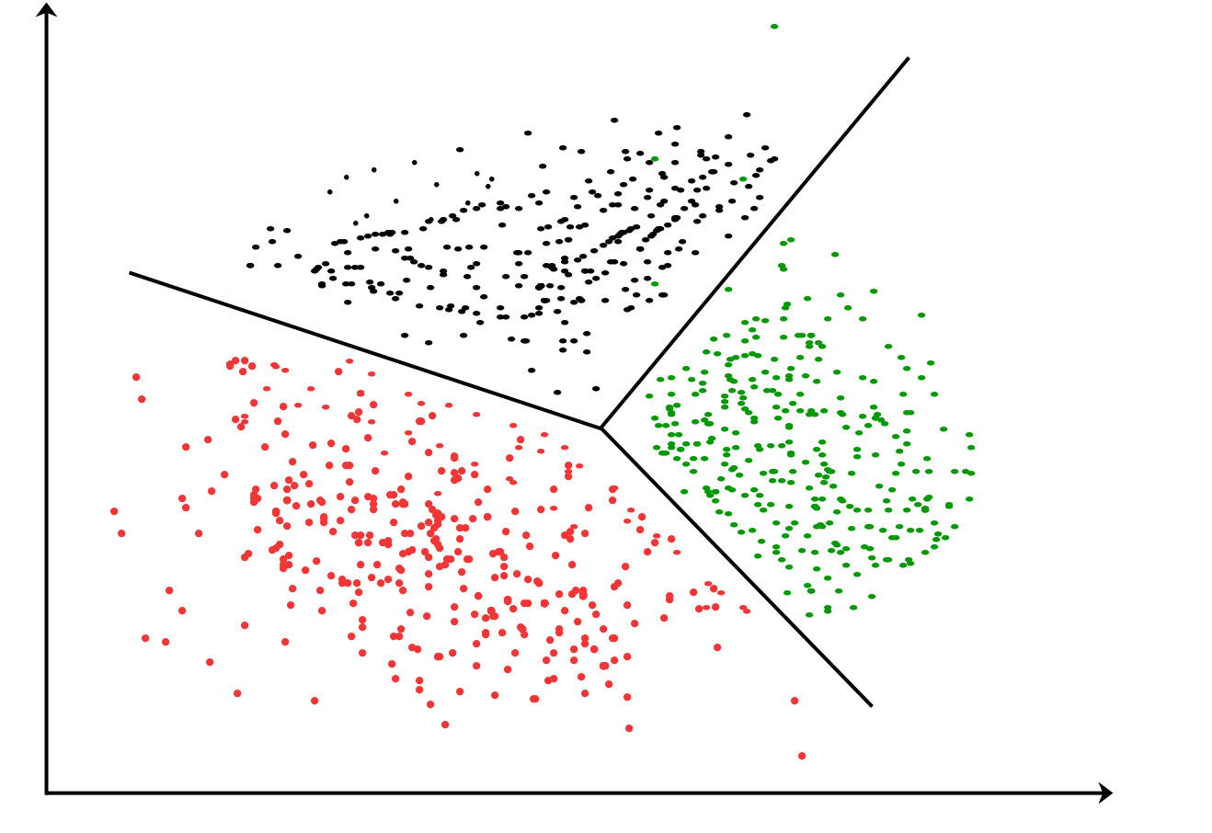
Machine learning analysis
•Step 4 Building a unique sleeping pattern
•Method: Unsupervised learning algorithms (Clustering)
•sort the dataset into distinct groups based on the risk level of sleep apnea, then provide effective treatment

Slide 16

Questions?

